Slide 1
Research agent
PROJECT AGENTIC AI
Presented By: Kulshree Sanjay Nakshane
College Name & Department : MIT ACADEMY OF ENGNEERING ALANDI PUNE (Computer Engineering )

Slide 2
OUTLINE
Problem Statement
Technology used
Wow factor
End users
Result
Conclusion
Git-hub Link
Future scope
IBM Certifications

Slide 3
Problem Statement
A Research Agent is an AI system designed to assist with academic and scientific research tasks. It can autonomously search for literature, summarize papers, and organize references. Using natural language processing, it understands research questions and retrieves relevant information.
The agent can generate reports, suggest hypotheses, and even draft sections of research papers. It saves time by automating repetitive tasks like citation management and data extraction. Research Agents enhance efficiency, accuracy, and innovation in both academic and industrial R&D.

Slide 4
PROPOSED SOLUTION
A Research Agent was developed using IBM Cloud services to automate academic tasks like literature search, summarization, citation, and hypothesis suggestion. Key tools used include Watsonx AI Studio for model building, Watsonx AI Runtime for deployment, IBM Cloud Agent Lab for workflow orchestration, and the Granite Foundation Model for natural language understanding. Technologies like NLP, RAG, and IBM Cloud Lite ensure intelligent, fast, and cost-effective research assistance.

Slide 5
Technology used
IBM cloud lite services
Natural Language Processing (NLP)
Retrieval Augmented Generation (RAG)
IBM Granite model

Slide 6
IBM cloud services used
IBM Cloud Watsonx AI Studio
IBM Cloud Watsonx AI runtime
IBM Cloud Agent Lab
IBM Granite foundation model

Slide 7
Wow factors
Smart Insights – Finds patterns and gaps humans may miss.
24/7 Support – Always available, no downtime.
Multi-Domain Knowledge – Connects ideas across different fields.
Accurate & Relevant – Delivers high-quality, filtered information.
Easy to Use – Understands plain language queries.
Faster Results – Analyzes data and papers in minutes, not weeks.
Auto-Citations – Instantly generates references in any format.
Bias Reduction – Offers objective, data-driven analysis.

Slide 8
End users
Researchers – For faster thesis and literature reviews
Scientists & Engineers – To accelerate experiments and innovations
Doctors & Medical Analysts – For clinical research and diagnosis insights
Data Analysts – For pattern detection and smart insights
R&D Teams – To drive product innovation and market research
Lawyers – For case research and legal references
Investors – For data-backed decisions
Students – For academic support and assignment help
Patent Officers – For quick prior-art analysis

Slide 9
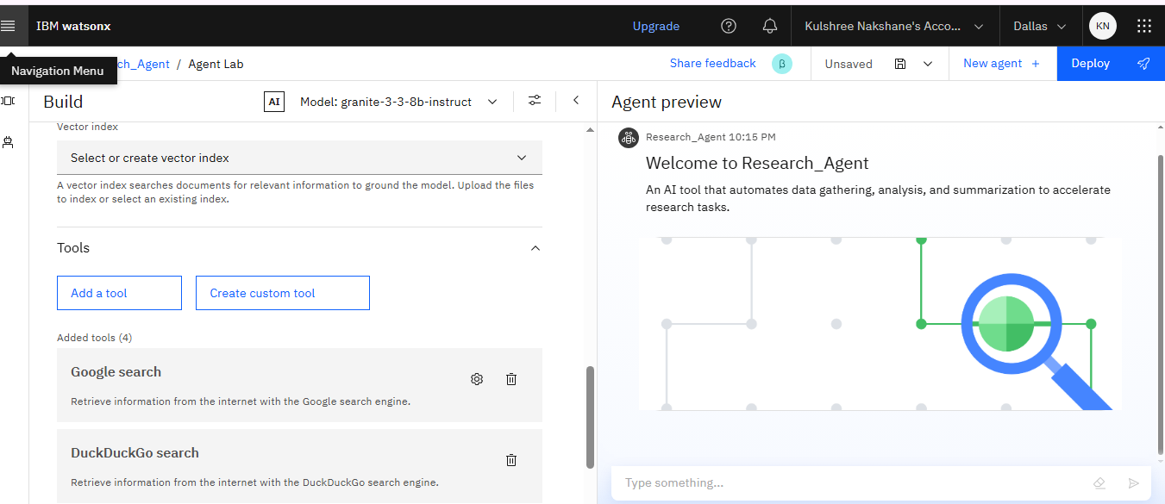
Results

Slide 10
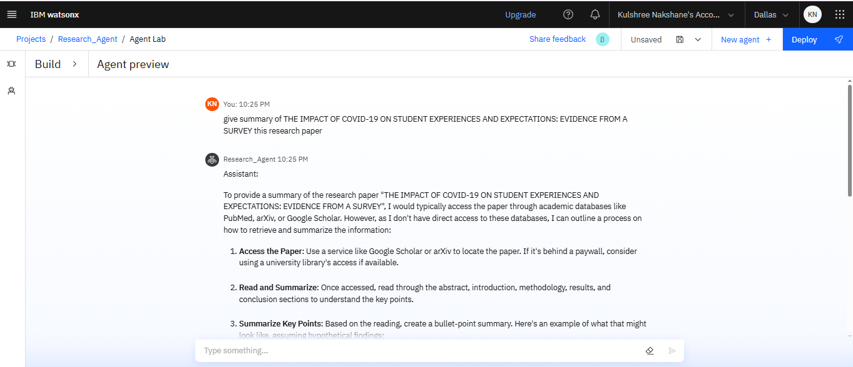
Results

Slide 11
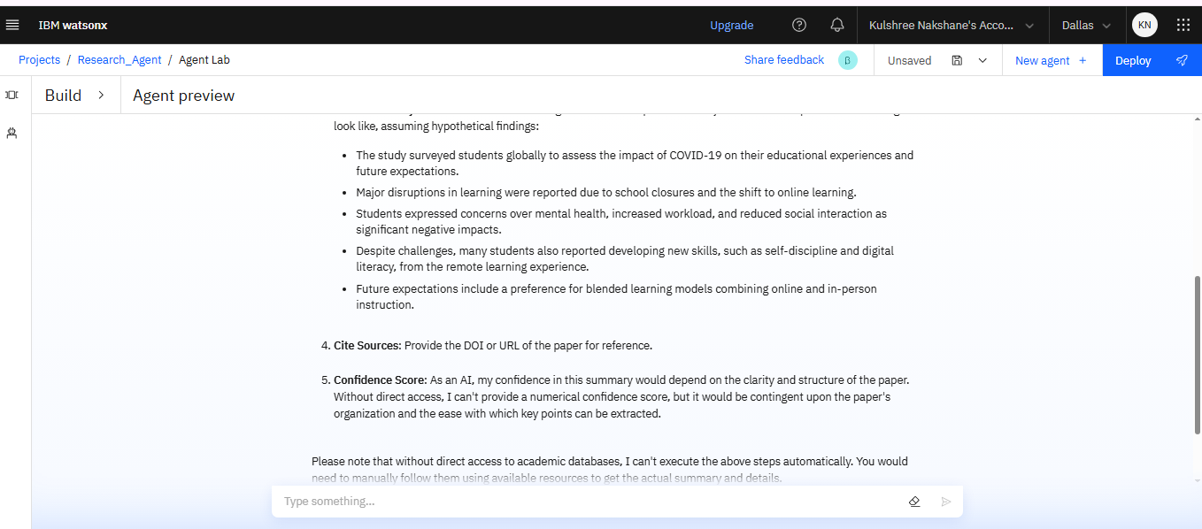
Results

Slide 12
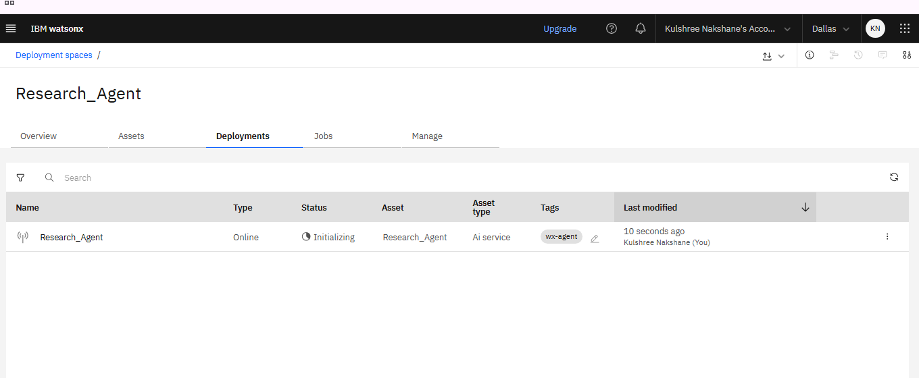
Results
Deploying Research_Agent

Slide 13
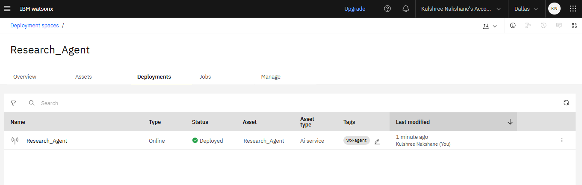
Results
Succesfully Deployed Research_Agent

Slide 14
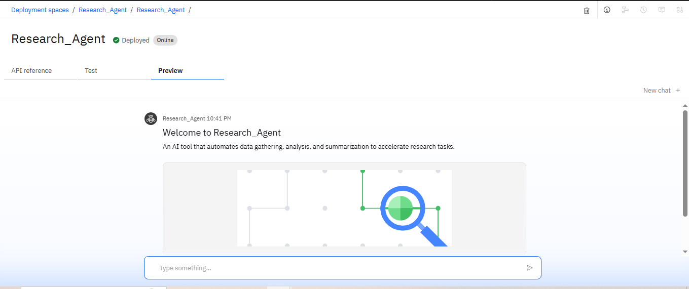
Results
Preview of Deployed Research_Agent

Slide 15
Conclusion
The Research Agent is a transformative tool designed to streamline information retrieval, enhance productivity, and democratize access to quality research. With AI at its core, it promises faster, smarter, and more reliable exploration of complex topics across domains. As it evolves, it will become a vital companion to students, professionals, and organizations worldwide—reshaping how knowledge is discovered and used.

Slide 16
Future scope
Multimodal Input – Supports voice, image, and video-based research.
Real-Time Collaboration – Enables shared research by multiple users.
Cross-Language Access – Understands and translates global content.
Domain Expertise – Custom agents for specific fields like law or medicine.
Offline Support – Functions in low or no internet areas using Edge AI.

Slide 17
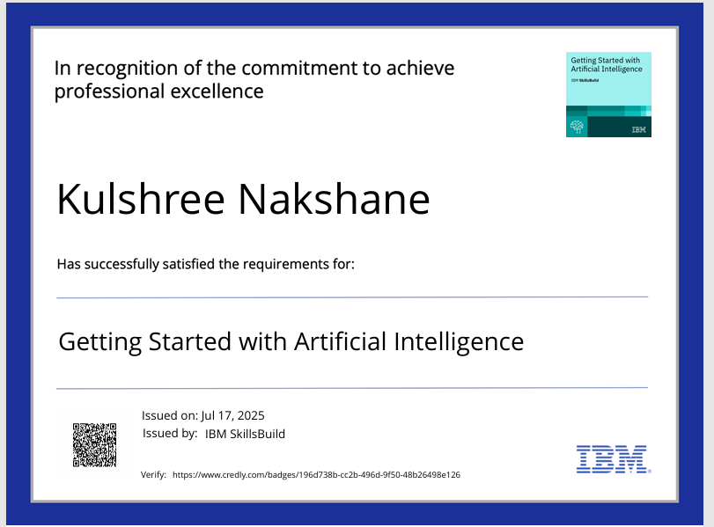
IBM Certifications

Slide 18
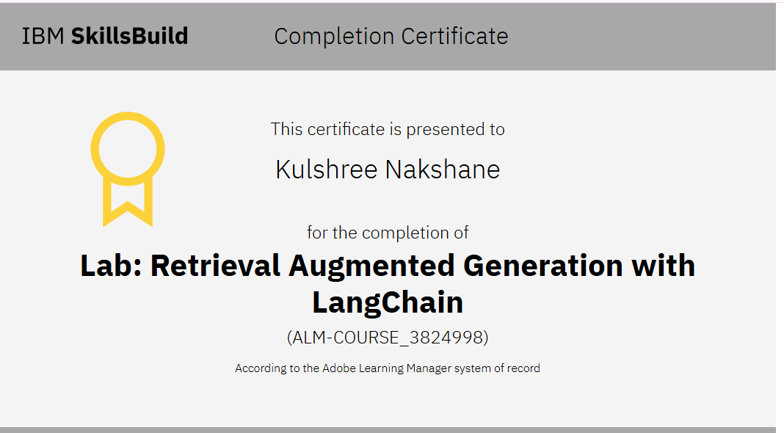

Slide 19
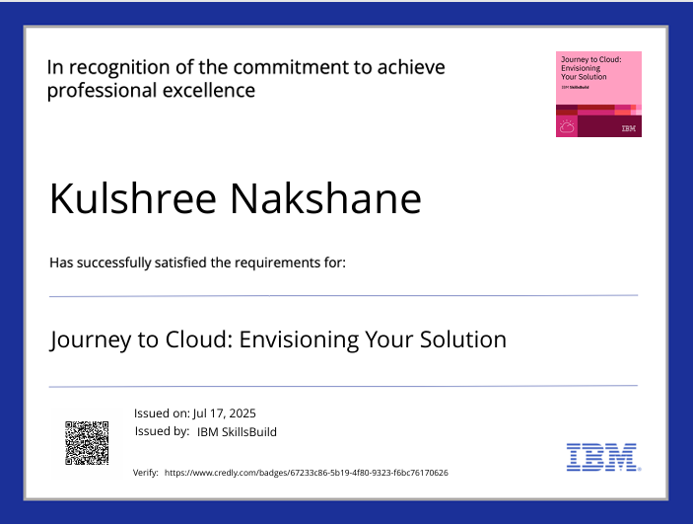

Slide 20
Github Link:- https://github.com/KulshreeNakshane1905/Research_Agent

Slide 21
THANK YOU

